Slide 1
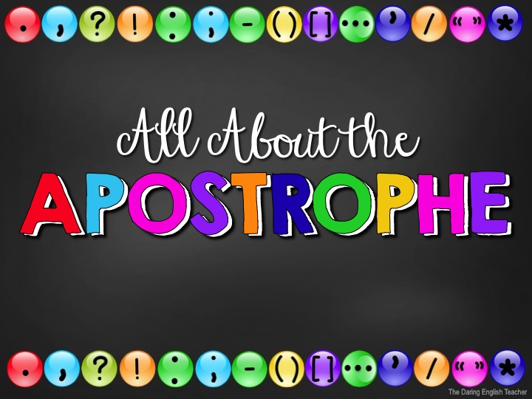

Slide 2
Punctuation
When we talk, we naturally pause and speak with intonation to communicate effectively.
When we write, we need to use punctuation to show these pauses and intonations.

Slide 3
Why Punctuate?
Using punctuation is important because it…
helps your writing flow.
increases the readers’ comprehension.
improves readability .
provides pauses.
conveys messages correctly.
If you punctuate incorrectly, you might write something with an entirely different meaning.

Slide 4
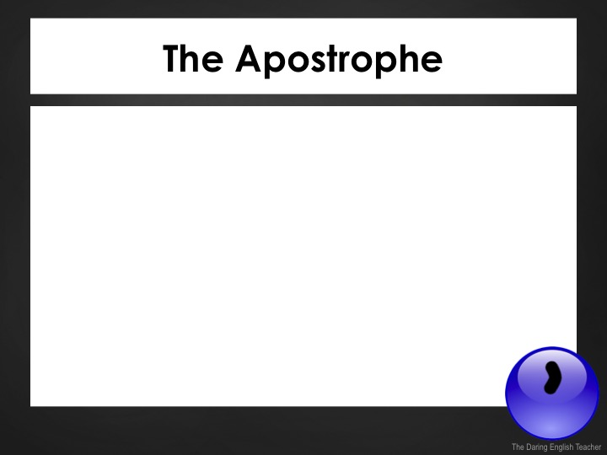
The Apostrophe
The apostrophe is a punctuation mark used to indicate possession or show contractions.
Aside from the comma, the apostrophe is one of the most misused punctuation marks.

Slide 5
The Apostrophe – Possession
Use an apostrophe to show possession.
Examples:
The sunglasses belong to Ray.
Those are Ray’s sunglasses.
We are going to a house that belongs to the Campbell family.
We are going to the Campbell’s.
Here, house is implied after Campbell’s.

Slide 6
The Apostrophe – Possession
If a word or name ends in an “s” just add an apostrophe after the “s” to show possession.
Examples:
The sunglasses belong to Chris.
Those are Chris’ sunglasses.
We are going to a house that belongs to Silas.
We are going to Silas’.
Here, house is implied after Silas’.

Slide 7
The Apostrophe – Possession
Examples:
The man’s hat…
The boss’ daughter… (add the apostrophe after the s)
Mr. Wilson’s house…
The school’s playground…
The cat’s tail…
That is Cara and Jeff’s game.

Slide 8
The Apostrophe – Plural Possession
Sometimes, you will need to show possession for a plural word –when multiple people or things own something.
In this case, add the apostrophe at the end of the plural word.
Example:
The kittens’ toys…
The babies’ blankets…

Slide 9

The Apostrophe – Plural Possession
Singular
Plural
The baby’s blanket is in the wash.
The puppy’s tail is so cute.
My sister’s friend is waiting in the car.
Here, there is only one sister.
The babies’ blankets are in the wash.
The puppies’ tails are so cute.
My sisters’ friend is waiting in the car.
Here, there are at least two sisters, but only one friend.

Slide 10
The Apostrophe – Possession
Third personal pronouns do not use an apostrophe to show possession.
Examples:
its = third person possessive pronoun
The cat was chasing its tail.
it’s = a contraction for it is
It’s going to be a glorious day.
It is going to be a glorious day.

Slide 11
Possession Rules
Add ‘s to a singular noun
This is Jenna’s pen.
That is the cat’s toy.
Add ‘s to a singular noun that ends in –s
This is Chris’s bed.
Our class’s pet Iguana eats crickets.
Add ‘ to a plural noun that ends in –s
These toys are the cats’ favorite toys.
The students’ exam grades are finally posted.

Slide 12
Possession Rules
Add ‘s to a plural noun that does not end in –s
The children’s snacks are on the table.
The mice’s nest is somewhere in the attic.
Add ‘s to the final noun to show joint possession.
This is Jenny and Lia’s favorite movie.
Those are Greg and Kayla’s tacos.

Slide 13
Possession Rules
Do not use an apostrophe when showing possession for a third person personal pronoun.
That is their cat.
This is our ball.
This is her homework.
These are his baseball cleats.

Slide 14
Possession Rules
Do not use an apostrophe when showing possession for a third person personal pronoun.
These possessive pronouns never need an apostrophe: its, hers, his, ours, yours, theirs.

Slide 15
Possession/Contraction
Its vs. It’s
Its shows possession & it’s = it is
The cat is chasing its tail (possession).
It’s (It is) too hot outside.

Slide 16
Possession/Contraction
Whose vs. Who’s
Whose shows possession & who’s = who is
Arlene, whose mother is Ellen, is coming today.
Who’s (Who is) bringing the chips?

Slide 17
Possession/Contraction
Theirs vs. There’s
Theirs shows possession & there’s = there is
This desk was theirs to use.
There’s (There is) a desk against the wall.

Slide 18

Possession/Plural
Bird’s vs. Birds’ vs. Birds
Bird’s shows singular possession, birds’ shows plural possession & birds is plural.
This is the bird’s nest. (1 bird)
This is the birds’ nest. (2+ birds).
The birds live in this nest.

Slide 19
The Apostrophe – Plural words
Do not add an apostrophe to a normal noun to make it plural.
Correct | Incorrect
The cats are playing. | The cat’s are playing.
Apostrophes are challenging. | Apostrophe’s are challenging.
My birthday parties are always fun. | My birthday party’s are always fun.

Slide 20
Other Uses
Apostrophes are also used to indicate when two words are joined together to form a contraction.
Examples:
Do not = Don’t
Will not = Won’t
Should have = Should’ve

Slide 21
The Apostrophe – Contractions
Use an apostrophe to replace omitted letters when forming a contraction.
Examples:
will not = won’t
should not = shouldn’t
I will = I’ll
could have = could’ve

Slide 22
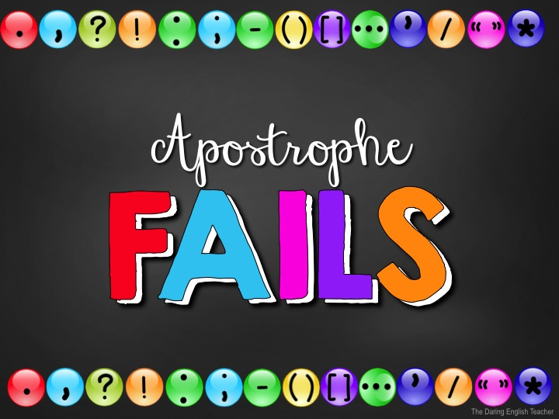

Slide 23
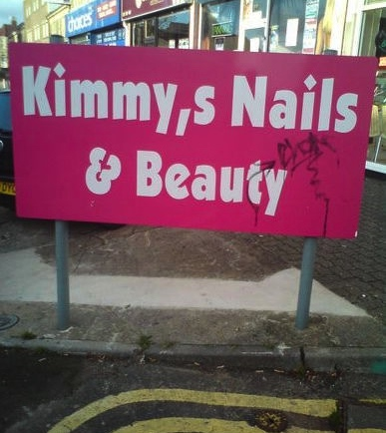
How Do You Correct This Fail?
Kimmy’s Nails & Beauty

Slide 24
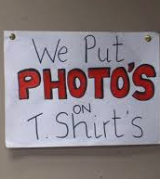
How Do You Correct This Fail?
We put photos on
t-shirts

Slide 25

How Do You Correct This Fail?
Being Responsible with your Child’s Education

Slide 26

How Do You Correct This Fail?
Friendly Ben says, “Let’s read again.”

Slide 27
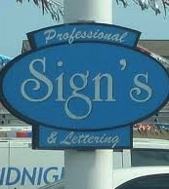
How Do You Correct This Fail?
Professional Signs & Lettering

Slide 28
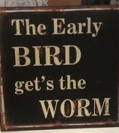
How Do You Correct This Fail?
The early bird gets the worm

Slide 29

How Do You Correct This Fail?
Ladies’ Fitness Studio

Slide 30
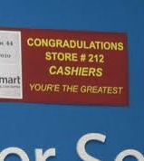
How Do You Correct This Fail?
Congratulations Store #212 Cashiers
You’re the greatest

Slide 31
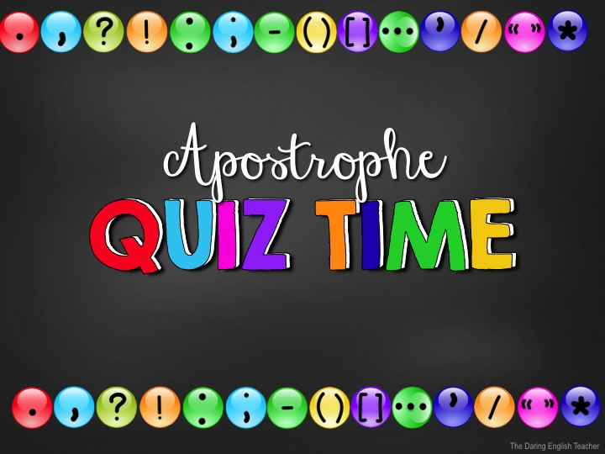

Slide 32
The Apostrophe – Possession
Make this possessive.
Plural baby
babies’

Slide 33
The Apostrophe – Possession
Make this possessive.
Singular dog
dog’s

Slide 34
The Apostrophe – Contractions
What is the contraction?
could not
couldn’t

Slide 35
The Apostrophe – Contractions
What is the contraction?
children
children’s

Slide 36
The Apostrophe – Contractions
What is the contraction?
mouse
mouse’s

Slide 37
The Apostrophe – Contractions
What is the contraction?
plural house
houses'

Slide 38
The Apostrophe – Contractions
What is the contraction?
Singular class
class’s

Slide 39
The Apostrophe – Contractions
What is the contraction?
Plural class
classes’

Slide 40
The Apostrophe – Contractions
What is the contraction?
I will
I’ll

Slide 41
The Apostrophe – Contractions
What is the contraction?
she is
she’s

Slide 42
The Apostrophe – Contractions
What is the contraction?
did not
didn’t

Slide 43
The Apostrophe – Contractions
What is the contraction?
will not
won’t

Slide 44
The Apostrophe – Contractions
What is the contraction?
I am
I’m

Slide 45
The Apostrophe – Contractions
What is the contraction?
could have
could’ve

